Slide 1
Reliability Applications Series, Parallel, Series-Parallel and Non-Series Parallel
ECE 313
Probability with Engineering Application
Professor Ravi K. Iyer
University of Illinois

Slide 2
Today’s Topics
Quick Review series, parallel, series-parallel and non-series parallel
m-out-of-n-systems
Special Case Triple Modular Redundancy

Slide 3
Application to Reliability Evaluation of Series, Parallel, Series-Parallel Systems
Consider the problem of computing reliability of so-called series-parallel systems.
A series system is one in which all components are so interrelated that the entire system will fail if any one of its components fails.
A parallel system is one that will fail only if all its components fail.
We will assume that failure events of components in a system are mutually independent. Consider a series system of n components.

Slide 4
Application to Reliability Evaluation (cont.)
For I=1,2,…,n, define events A_{i}=“Component i is functioning properly.” The reliability, R_{i}, of component i is defined as the probability that the component is functioning properly. Then: R_{i}=P(A_{i}).
By the assumption of series connections, the system reliability:
(“The system is functioning properly.”)
(2.1)

Slide 5
Example of Effect of Complexity on Reliability
Remember how quickly system reliability degrades with an increase in complexity.
For example, if a system consists of five components in a series, each having a reliability of 0.970, then the system reliability is 0.970⁵=0.859.
If the system complexity is increased so that it contains ten similar components, its reliability is reduced 0.970¹⁰=0.738.
Consider what happens to system reliability when a large system such as a computer system consists of tens to hundreds of thousands of components.

Slide 6
Increasing Reliability Using Parallel Redundancy
One way to increase the reliability of a system is to use redundancy, i.e., to replicate components with small reliabilities. This is called parallel redundancy.
Consider a system consisting of n independent components in parallel; the system fails to function only if n components have failed.
Define event A_{i}=“The component i is functioning properly” and
A_{p}=“The parallel system of n components is functioning properly.”
Also let R_{i}=P(A_{i}) and R_{p}=P(A_{p}).
To establish a relation between A_{p} and the A_{i}’s, it is easier to consider the complementary events.
Thus: “The parallel system has failed.”
= “All n components have failed.”
Therefore, by independence:

Slide 7
Increasing Reliability Using Redundancy (cont.)
Now let F_{p}=1-R_{p} be the unreliability of the parallel system, and similarly let F_{i}=1-R_{i} be the unreliability of component i.
Then, since A_{i} and A_{i} are mutually exclusive and collectively exhaustive events, we have:
And:
Then:
And:

Slide 8
Product Law of Unreliabilities
Thus, for parallel systems of n independent components, we have a product law of unreliabilities analogous to the product law of reliabilities of series systems.
If we have a parallel system of five components, each with a reliability of 0.970, then the system reliability is increased to:
However, we should be aware of the law of diminishing returns.

Slide 9
Reliability Curve of a Parallel Redundant System
1.0
0.99
0.98
Reliability R_{p}(n)
0.97
0.96
0.95
1.0 2.0 3.0 4.0 5.0 6.0 7.0 8.0 9.0 10.0
Number of components n, each with R=0.97

Slide 10
Reliability of Series-Parallel Systems
We can use formulas parallel and series systems in combination to compute the reliability of a system having both series and parallel parts (series-parallel systems).
Consider a series-parallel system of n serial stages, where stage i consists of n_{i} identical components in parallel.

Slide 11
Reliability of Series-Parallel Systems (cont.)
The reliability of each component of stage i is R_{i}.
Assuming that all components are independent, R_{sp} :

Slide 12
Series-Parallel System Example
Consider the series-parallel system shown in the diagram below, consisting of five stages, with n₁=n₂=n₅=1, n₃=3, n₄=2, and R₁=0.95, R₂=0.99, R₃=0.70, R₄=0.75, and R₅=0.9.
Then:
R₃
R₄
R₁
R₂
R₃
R₅
R₄
R₃

Slide 13
Application of Bayes Complex system Example
Consider evaluating the reliability R of the five-component system. The system is said to be functioning properly only if all the components on at least one path from point A to point B are functioning properly.
C₁
C₄
A
C₂
B
C₃
C₅

Slide 14
Bayes’ Formula Example 3 (cont.)
Define for i = 1, 2, …, 5 event X_{i} = “Component i is functioning properly”
let R_{i} = reliability of component i = P(X_{i})
let X = “System is functioning properly
let R = system reliability = P(X)
Thus X is a union of four events
These four events are not mutually exclusive. Therefore, we cannot directly use axiom (A3). Note, however, that we could use relation (Rd), which does apply to union of interesting events. But this method is computationally tedious for a relatively long list of events. Instead, using the theorem of total probability, we have:

Slide 15
Bayes’ Formula Example 3 (cont.)
Now to compute P(X|X₂)observe that since component C₂ is functioning, the status of components C₁ and C₃ is irrelevant. The system is equivalent to two components C₄ and C₅ in parallel. Therefore we get:
To compute P(X|X₂), since C₂ is known to have failed, the resulting system is a series-parallel one whose reliability is:
Combining previous equations and substituting, we have:

Slide 16
ZJUI Lecture Non-Series parallel and Triple Modular Redundancy
Another Non Series-Parallel example
Bernoulli Trials
An application of Bernoulli trials: Triple Modular redundancy - TMR
Announcements:
HW 3 on Thursday and due the following Thursday 11:59pm

Slide 17
Reliability of Series-Parallel Systems
summary
Expressions for parallel and series systems and in combination to compute the reliability and failure probabilities (series-parallel systems).
Application of conditional probability to resolve a non-series parallel system example

Slide 18
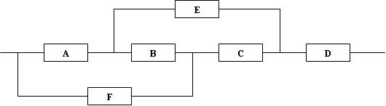
Non-Series Parallel System Example
B
B Working
B Not Working
E
A
E
A
C
D
D
F
C
F
B (“ short ”) works
B (“ open ”) fails
R_{sys} = R_{B} P(system works | B works) + (1 - R_{B}) {R_{D}[1 - (1 - R_{A}R_{E})(1 - R_{F}R_{C})]}

Slide 19
Non-Series-Parallel-Systems (cont.)
B Working
A
D
F
E
B (“ short ”) works, C (“ short ”) works
A
C
D
A
E
D
F
B (“ short ”) works
B (“ short ”) works, C (“ open ”) fails
Reduction with B and C replaced
P(system works | B works) = R_{C}{R_{D}[1 - (1 - R_{A})(1 - R_{F})]} + (1 - R_{C})(R_{A}R_{D}R_{E})
Letting R_{A} ....R_{F} = R_{m} yields R_{sys} = R⁶_{m} - 3R⁵_{m} + R⁴_{m} + 2R³_{m}

Slide 20
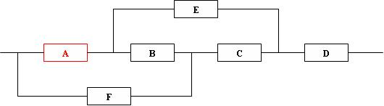
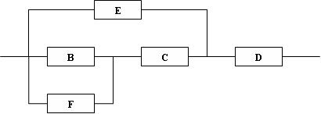
Non-Series Parallel System Example
A Working

Slide 21

Non-Series Parallel System Example
A Not Working

Slide 22
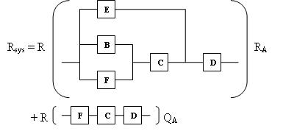
Non-Series Parallel System Example

Slide 23
Next: Bernoulli Trials and application to a TMR system
Bernoulli Trials
Triple Modular Redundant Systems

Slide 24
Bernoulli Trials
Physical situations of interest:
1. Observe n consecutive executions of an if statement, with success = “then clause is executed” and failure =”else clause is executed”
2. Examine components produced on an assembly line, with success = “acceptable” and failure = “defective”
3. Transmit binary digits through a communication channel, with success = “digit received correctly” and failure = “digit received incorrectly”

Slide 25
Bernoulli Trials (cont.)
4. Consider a time-sharing computer system that allocates a finite quantum (or time slice) to a job scheduled for processor service. Observe n time-slice terminations, with success = “job has completed processing” and failure = “job still requires processing and joins the tail end of the ready queue of processes
Job arrival
Job completion
CPU
Ready queue

Slide 26
Bernoulli Trials (Cont’d)
Consider a random experiment that has two possible outcomes,. Let the probabilities of the two outcomes be p and q, respectively, with p + q = 1.
Now consider the compound experiment: A sequence of n independent repetitions of this experiment. Such a sequence is a sequence of Bernoulli trials.

Slide 27
Bernoulli Trials (cont.)
Let 0 denote failure and 1 denote success. Let S_{n} be the sample space of an experiment involving n Bernoulli trials, defined by:
S₁ = {0, 1}, S₂ = {(0, 0), (0, 1), (1, 0), (1, 1)}
S_{n} = {2^{n} n-tuples of 0’s and 1’s}.
The probability assignment over the sample space S₁ is already specified: P(0) = q ≤ 1, P(1) = p ≤ 1, and p + q = 1. We wish to assign probabilities to the points in S_{n}.
Let A_{i} = “Success on trial i” and A_{i} = “Failure on trial i” then P(A_{i}) = p and P(A_{i}) = q.

Slide 28
Bernoulli Trials (cont.)
Consider s an element of S_{n} such that s = (1, 1, …, 1, 0, 0, …, 0) [k 1’s and (n-k) 0’s]. Then the elementary event {s} can be written:

Slide 29
Bernoulli Trials (cont.)
Therefore:
Similarly, any sample point with k 1’s and (n-k) 0’s is assigned probability p^{k}q^{n-k}. Noting that there are such points, the probability of obtaining exactly k successes in n trials is :
Verify that expression for P(s) is a legitimate probability assignment over the sample space Sn since
by the Binomial theorem.
k = 0, 1, …, n

Slide 30
Example
Consider a binary communication channel transmitting coded words of n bits each. Assume that the probability of successful transmission of a single bit is p (and the probability of an error is q = 1-p), and the code is capable of correcting up to e (e >=0) errors.
For example, if no coding or parity checking is used, then e = 0. If a single error correcting Hamming code is used then e =1.
If we assume that the transmission of successive bits is independent, then the probability of successful word transmission is:

Slide 31
Bernoulli Trials Example m-out-of-n system
Consider a system with n components that requires m (≤n) or more components to function for the correct operation of the system (called m-out-of-n system).
If we let m=n, then we have a series system; if we let m = 1, then we have a system with parallel redundancy.
Assume: n components are statistically identical and function independently of each other.
Let R denote the reliability of a component ( and q = 1 - R gives its unreliability), then the experiment of observing the status of n components can be thought of as a sequence of n Bernoulli trials with the probability of success equal R.

Slide 32
Bernoulli Trials Example (cont.)
Now the reliability of the system is:
It is easy to verify that:

Slide 33
Bernoulli Trials TMR System Example
As special case of m-out-of-n system, consider a system with triple modular redundancy (TMR). In such a system there are three components, two of which are required to be in working order for the system to function properly (i.e., n = 3 and m = 2). This is achieved by feeding the outputs of the three components into a majority voter.
R
Input
Output
R
Voter
R
Triple-triple redundant 777 primary flight computer
IEEE Xplore
https://ieeexplore.ieee.org › document
by YC Yeh · 1996 · Cited by 451 — The heart of the FB concept is the use of triple redundancy for all hardware resources: computing system, airplane electrical power, hydraulic power ….

Slide 34
Bernoulli Trials TMR System Example (cont.)
The reliability of TMR system is given by the expression:
and thus Note that:
Thus TMR increases reliability over the simplex system only if the simplex reliability is greater than 0.5; otherwise decreases reliability
Note: the voter output corresponds to a majority; it is possible for two or more malfunctioning units to agree on an erroneous vote.

Slide 35
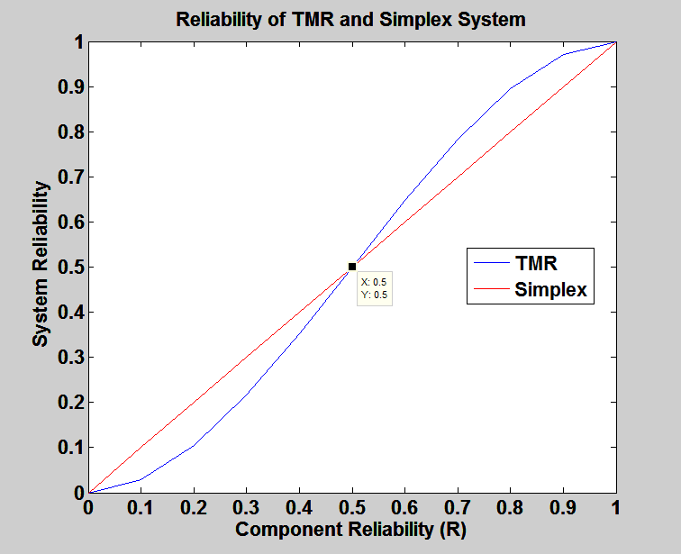
Reliability of TMR vs. Simplex

Slide 36
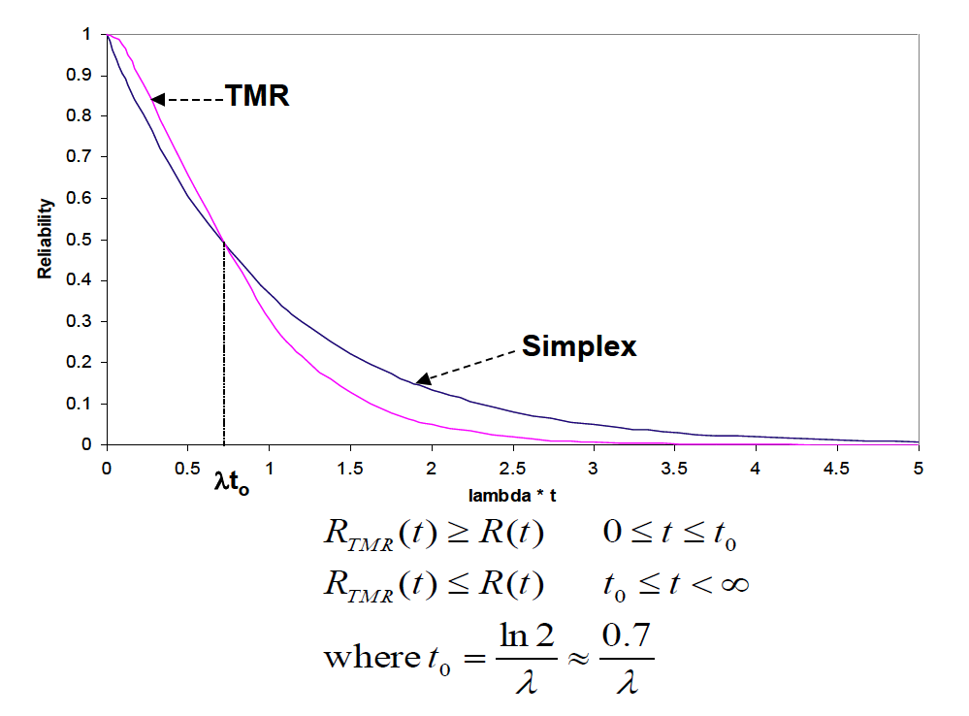
Reliability of TMR vs. Simplex

